Slide 1

Data Bootcamp Final Project Presentation
COVID19 AND ITS IMPACT ON EDUCATION, SOCIAL LIFE AND MENTAL HEALTH OF STUDENTS

Slide 2

About Me
I am a reliable and result oriented person with a MSc in Accounting and Finance and over 10years of experience supporting business development as part of a diligent financial team. Recently upskilling as part of a Data Analysis with Project Management Bootcamp and eager for a continuous professional development within a challenging data driven environment.
Notes:
….I am excited about graduating from the Data Analytics boot camp.

Slide 3
My Project - Objectives
To analyse the impact of Covid19 on education, social life and mental health of students. Using a cross sectional survey conducted with a sample size of 1182 students of different age groups from different educational institutions.
To see if health issues are been affected by time spent on online classes.
To know if there is a correlation between time spent on social media, sleep and fitness.

Slide 4
My Project - Excel Findings
From the dataset, I found out that the average time a student spent on online class was 3.2hours in a day during the lockdown. I also found that out of a total of 1182 students, only 98 students had an Excellent rating of online experience and 230 students had a Good rating of online experience. This is a total of 328 students while the remaining students had an average, poor / very poor rating of online experience. This shows that 72% of the students had a bad online experience during Covid19 and this has impacted their education adversely. Also from the dataset, I found out that 161 students had health issues during lockdown and 1,021 students had no health issues. Lastly, I put the students into age group; 20years and below = 717 students, 21yrs – 30yrs = 397students, 31yrs – 40yrs = 59 students and 41yrs and above = 9 students

Slide 5
My Project - SQL Analysis
From the query result, I was able to find out that most of the students that had an excellent and good rating of online experience were 30years of age and below. Also, I found that the average time spent on line class by a student was approximately 3 hours a day. Then, I queried for students that spent averagely 3hrs and above on online class and are 30years and below with an online rating experience of good and excellent which totalled 204 students. While 96 students within the same age group spent less than 3hours on online class in a day. I also found out that 161 students had health issues during lockdown while 1,021 students did not have health issues. Out of the 161 students, 154 students were 30years and below which is a very significant number. Likewise, out of the 1,021 students with no health issues, 960 students were 30years of age and below.

Slide 6
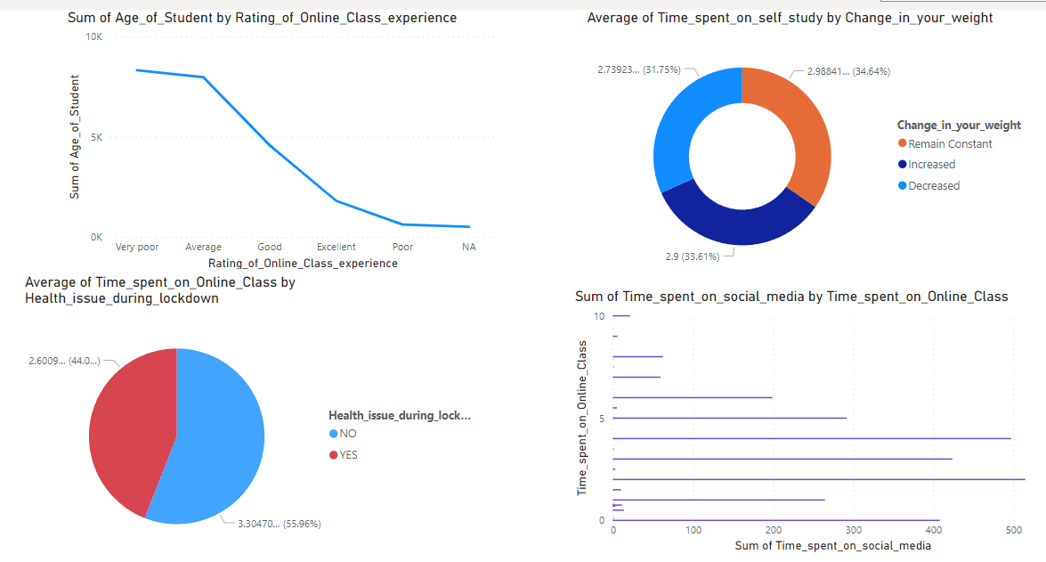
My Project - Dashboard

Slide 7



My Project - Recommendations/Insights
Based on my findings, I would recommend that students be encouraged to attend face to face classes as this will enhance their performance. Also, the rating of on online responses does not have a positive correlation with Health issues during lockdown.

Slide 8
Challenges
I was unable to put the students into different age groups when I was doing my visualisation so that I can narrow down my findings instead of using sum of age. Also, the dataset I used had only 68 students that are above 30years of age compared with 1,114 students that are 30years and below and this might not give an accurate result.

Slide 9
Conclusion and Key Learnings
HINT:
Reflection on Key learnings
Why did you choose to transition to Data Analytics and what role would you like to work in following what you’ve learned.
What are your top 3 key learnings: Educationally, Personally, Career-wise.
Should show how you used project management principles, data SQL , Tableau , Python where necessary

